Slide 1
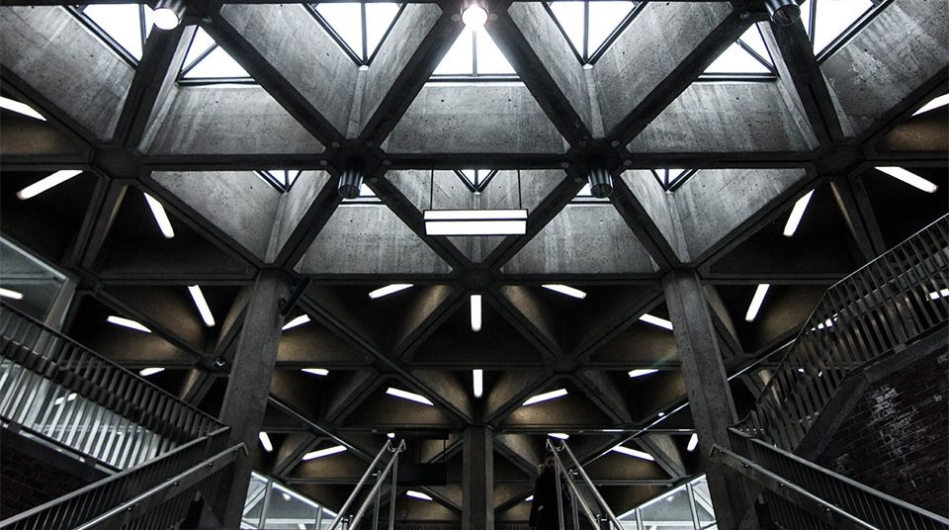
SyRIA TEL CHURN RATE
PHASE 3: PROJECT

Slide 2
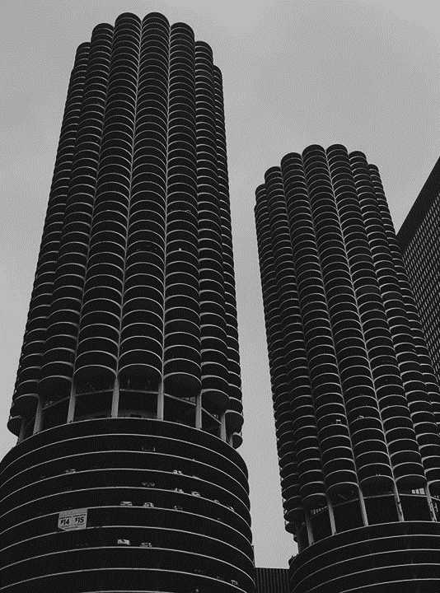
OVERVIEW
This project has been undertaken to determine how SyriaTel Company can predict if a customer will soon end their subscription to the telephone service.

Slide 3

BUSINESS UNDERSTANDING
The stakeholder will be SyriaTel as they assess whether they can determine that a customer will opt-out of their service soon and the predictors that they will opt out. Then I will construct a predictive model that will give recommendations as to how they can reduce their costs incurred by customers who do not stay very long. This could be from reducing capital expenditure or revenue expenditure on certain services they offer.

Slide 4

Title
KEY QUESTIONS
1. What are the features or determinants of customer churn?
2. What is the customer churn rate and how can it be improved upon based on the data?
3. What is the core services they offer and can costs of other services be reduced in order to maximize the core service?

Slide 5
MODELLING
METHODS USED
Simple Logistic Regression
SMOTE (Oversampling)
RandomUndersampling
Logistic Regression with Cross validation
Recursive Feature Elimination
SMOTE + Cross Validation

Slide 6
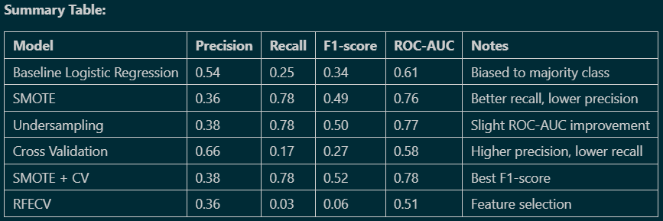
EVALUATION

Slide 7
General Recommendation
No single model is perfect: There is always a trade-off between catching more churners (recall) and not bothering loyal customers (precision).
Best model: The best model for the business use case would be SMOTE + CV as it is a better overall model in terms of F1 score
Next steps: Consider trying more advanced models (e.g., Random Forest, XGBoost) and further tuning.

Slide 8
THANK YOU
GITHUB: Eugene-Maina72

